Slide 1

ECHOKNIGHT
By
Abirami K (91762115002)
Lokanya S (91762115023)
Sujitha T (91762115040)
Guided by
Mrs.P. Anbuselvi , M.E.,

Slide 2
INTRODUCTION
EchoKnight is a cutting-edge chess application that revolutionizes the game with advanced voice recognition technology, allowing users to command their next move by simply speaking the position. Offering three difficulty levels, EchoKnight employs a heuristic approach for casual play and artificial intelligence for expert-level challenges. With stunning graphics and an immersive interface, EchoKnight provides an engaging experience for players of all skill levels.

Slide 3

OBJECTIVES
Objective: To create an inclusive and accessible chess application, EchoKnight, that:
Empowers physically disabled individuals to play chess effortlessly using voice commands, promoting equal access to gaming and cognitive development.
Attracts and engages children with its visually stunning graphics and intuitive voice command technology, making learning chess a fun and interactive experience.
Enables visually impaired individuals to play chess through voice commands , ensuring equal participation and enjoyment of the game

Slide 4
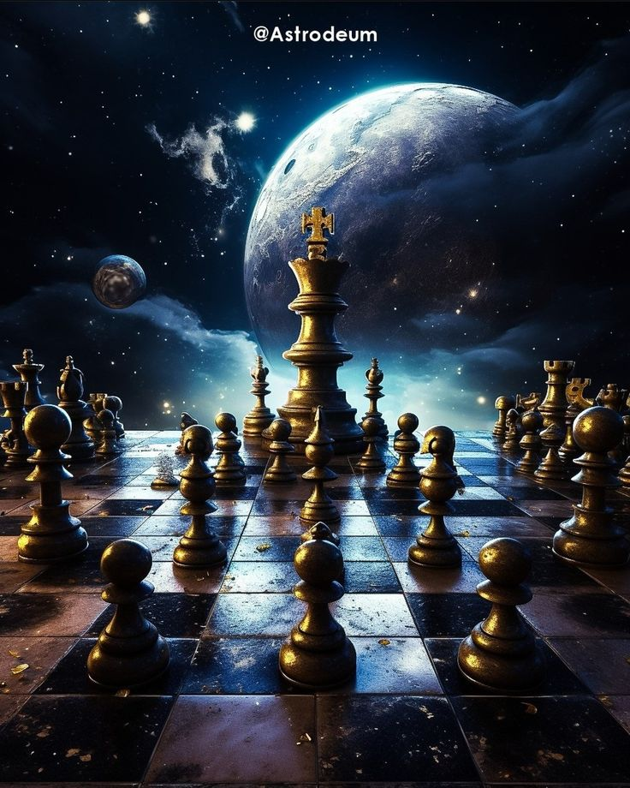
ABSTRACT
EchoKnight is an innovative chess app that revolutionizes gameplay with voice recognition, allowing players to control moves via voice commands. Designed for accessibility, it suits all skill levels and abilities, including children, visually impaired users, and those with physical disabilities. Advanced algorithms enhance gameplay, while stunning graphics, animations, and sound effects bring each move to life. Combining inclusivity with cutting-edge technology, EchoKnight redefines chess for everyone.

Slide 5
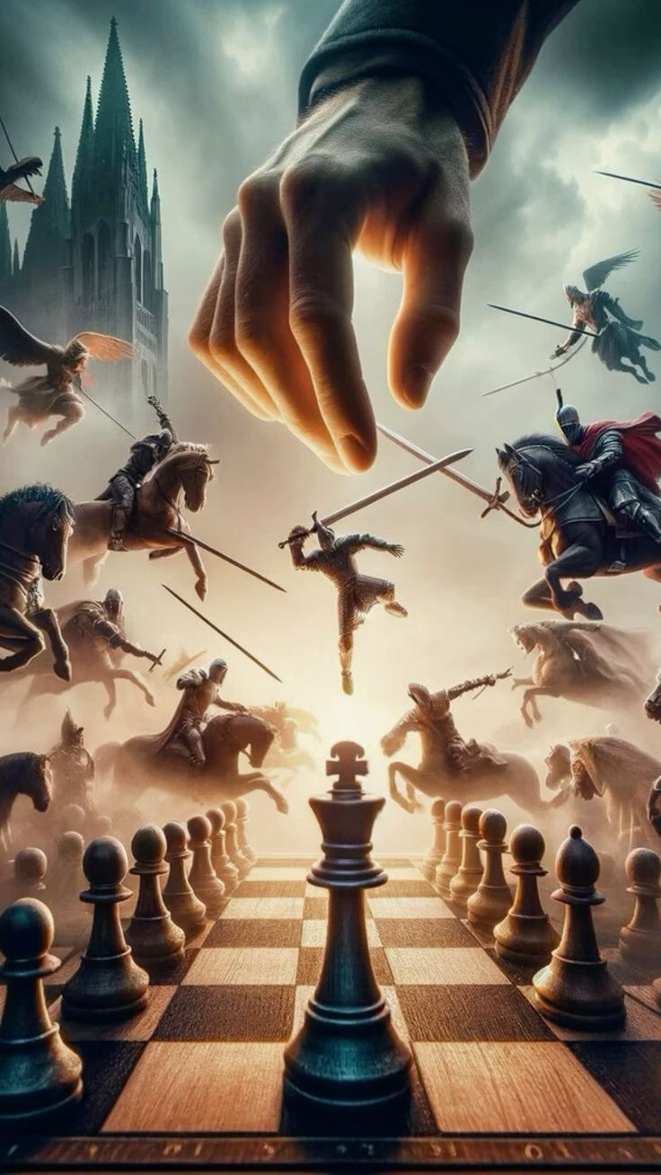
WORKFLOW
START
EXIT
NEW GAME
BY VOICE
BY MOUSE
PLAY

Slide 6
LITERATURE SURVEY
TITLE | YEAR | AUTHOR | FEATURES | ADVANTAGES | DISADVANTAGES
Speech recognition based chess system for visually challenged . | 2017 | Neha Jain, Somya Rastogi | Overview of speech recognition technology , its evolution, mechanisms, and challenges | Comprehensive analysis of speech recognition evolution and technology Provides insight into advancements in the field | Limited coverage on recent advancements
The effects of computer on competitive chess | 2007 | Ethan Modi and Kymberly Acuna | Overview of speech recognition technology Provides a historical perspective on the evolution of speech recognition systems. | Explains the mechanisms involved in speech recognition, such as Acoustic Modeling and Language Modeling. Discusses the advancements and challenges in the field. | Limited focus on the most recent advancements in speech recognition technology.
Animation - A Study and Comparison of Concepts and Software Issues | 2003 | Alan Beesley | Comparison between traditional and computer-generated animation, including software issues and rendering. | Detailed historical perspective of animation. Comparison between different animation techniques and software. | Focus on older software and techniques, might not cover the latest advancements in animation technology

Slide 7

FRONTEND
The Unity UI system is used to create an engaging front end for the game.
The render mode is set to design canvases for displaying 2D objects like buttons.
Buttons are arranged thoughtfully on the canvas to enhance the user experience.
C# scripts are attached to buttons to handle logic using OnClick events.
A visually appealing background complements the game’s theme.

Slide 8
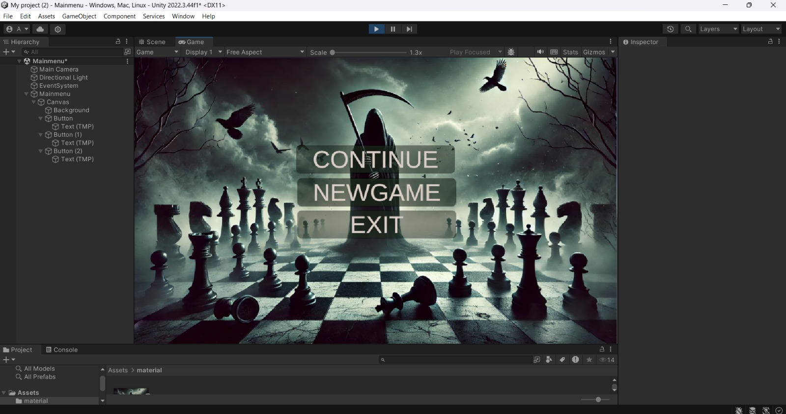

Slide 9
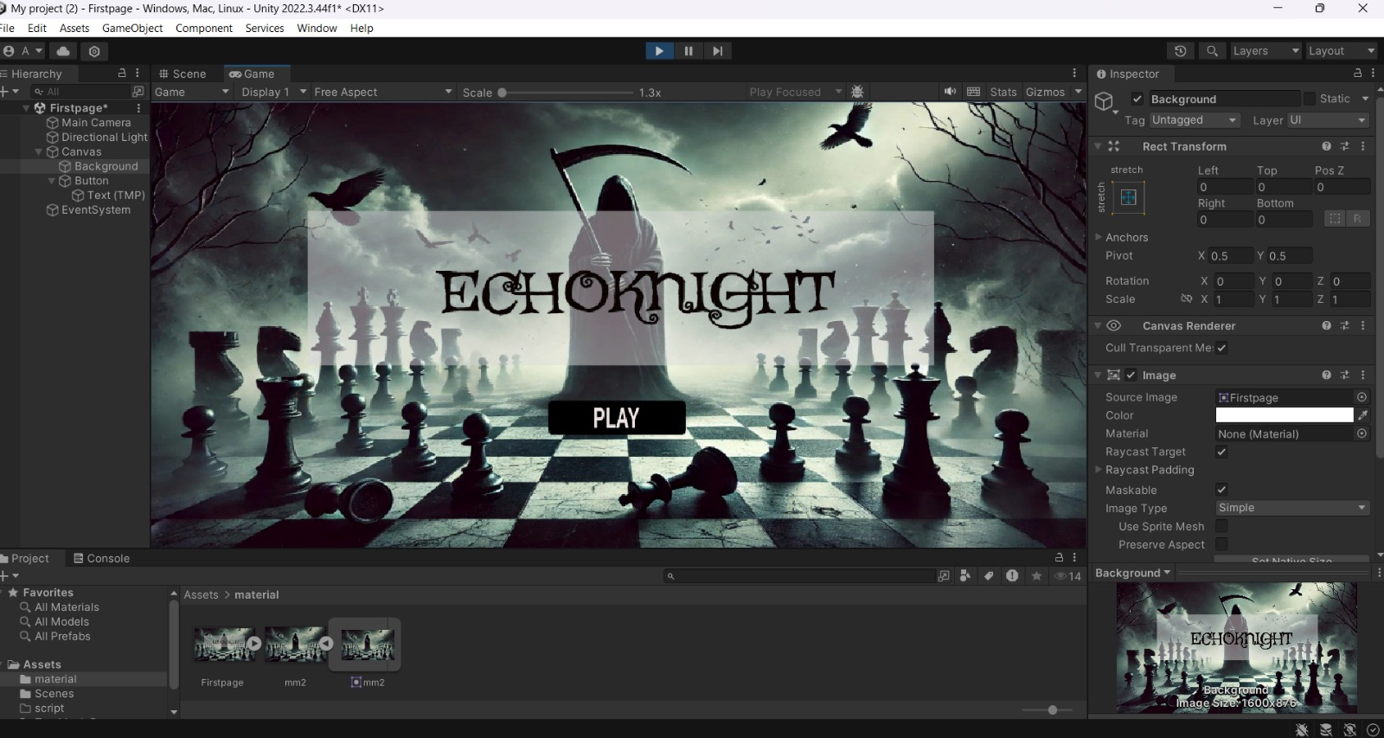

Slide 10
CREATION OF CHESSBOARD
Create an empty GameObject named "ChessBoard" at the origin and a "Square" GameObject with a Cube component, scaled flat and positioned appropriately.
Convert the Square GameObject into a prefab by dragging it into the Project panel, then delete the original.
Attach a ChessBoardCreator.cs script to the ChessBoard GameObject to instantiate the Square prefab in an 8x8 grid with alternating colors.
Link the Square prefab to the script in the Inspector and optionally add chess pieces, materials, and adjust the camera for a better view.

Slide 11
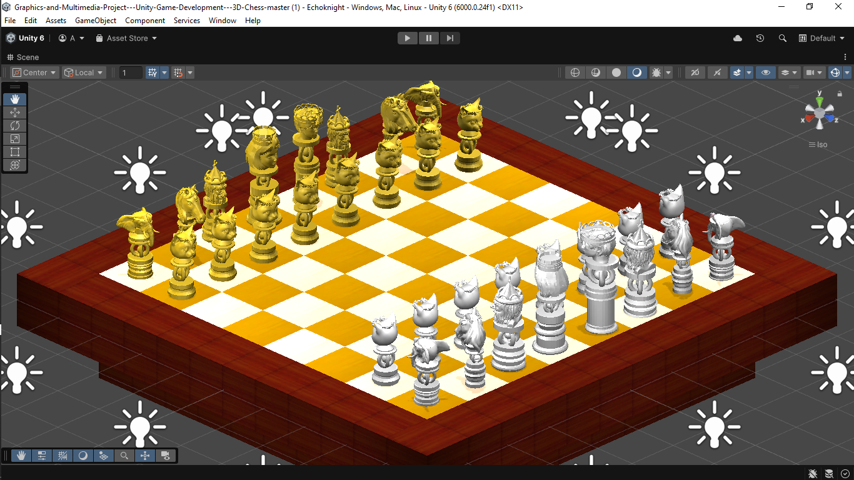

Slide 12
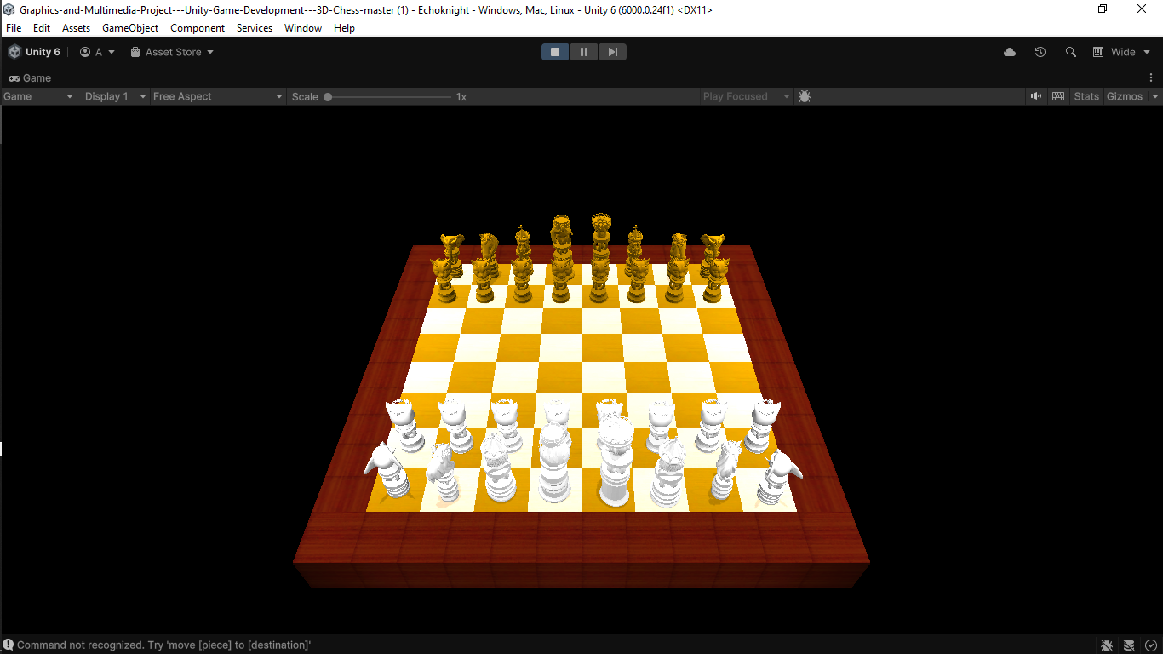

Slide 13

CREATION OF CHESSCOINS
Blender is used to create detailed 3D chess pieces by shaping, scaling, translating, and rotating geometric models like spheres, cylinders, and cones.
Different Blender modes, including Object Mode, Edit Mode, and Sculpt Mode, enable precise modeling, editing, and polishing of the 3D shapes.
Coloring and texturing are applied through painting and UV mapping techniques to finalize the models.

Slide 14
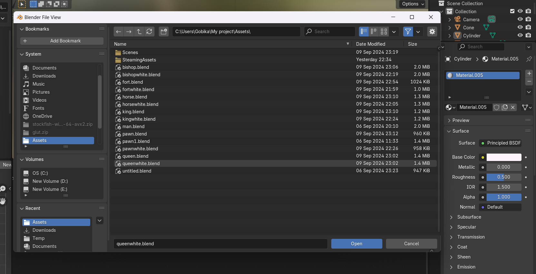

Slide 15
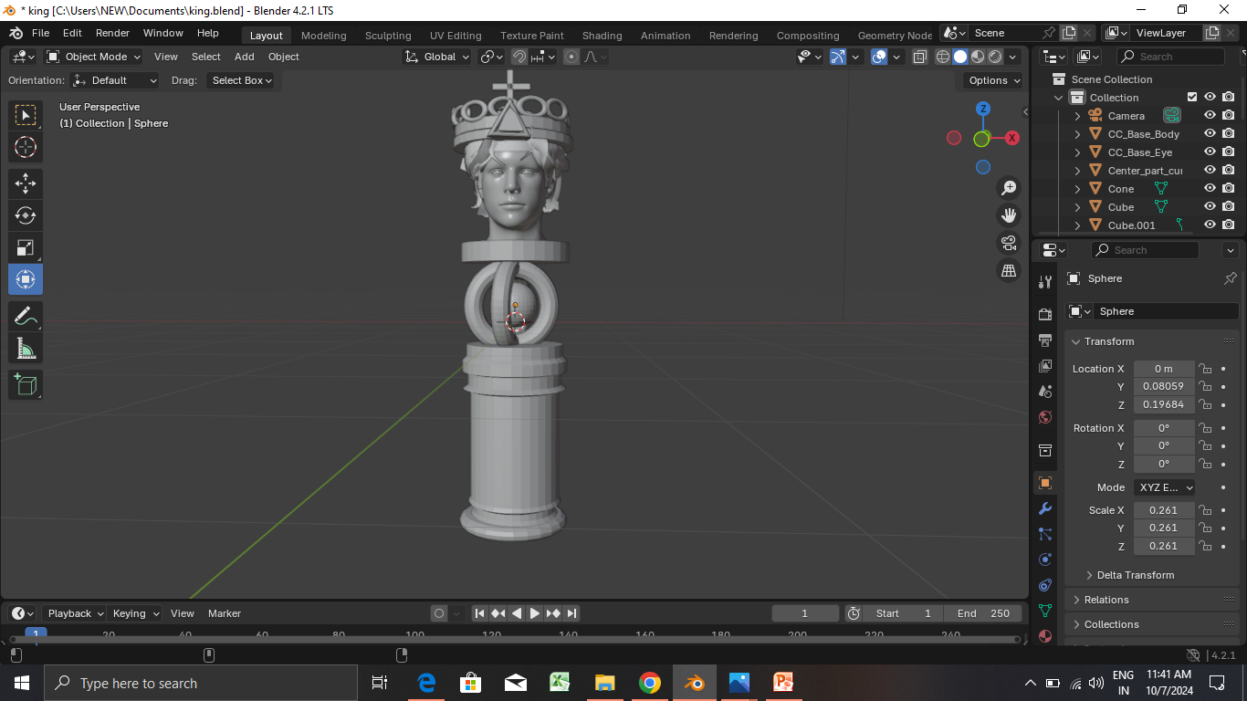
King Coin

Slide 16
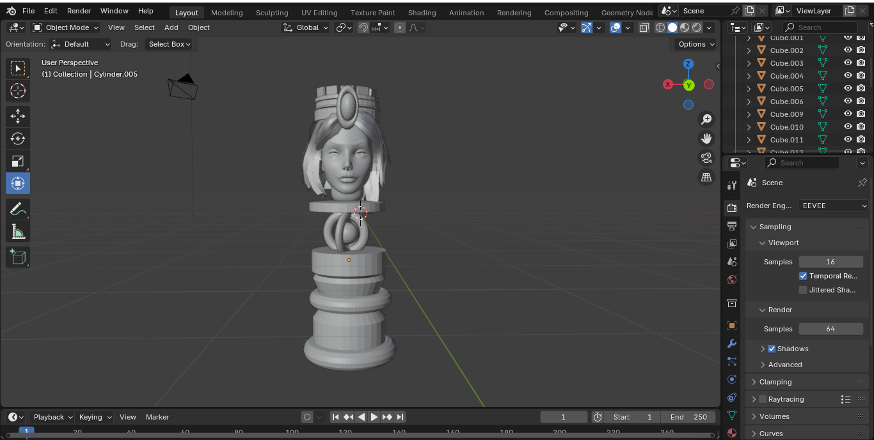
Queen Coin

Slide 17
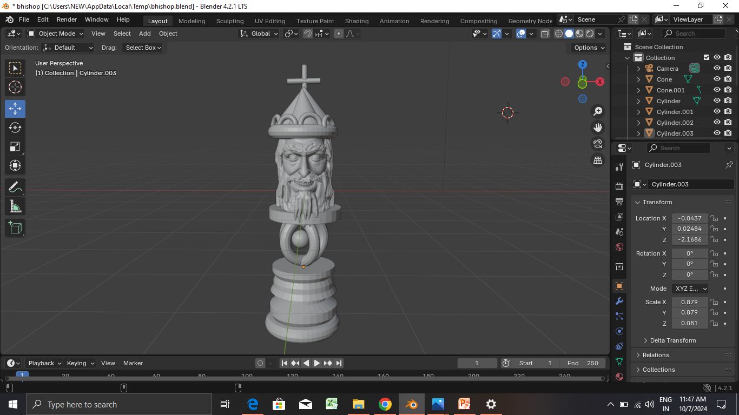
Bishop Coin

Slide 18
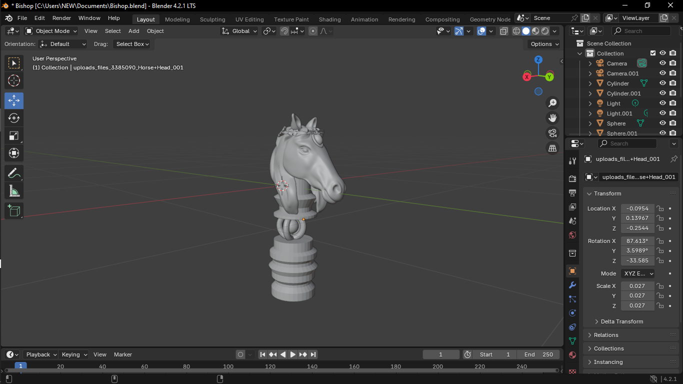
Knight Coin

Slide 19
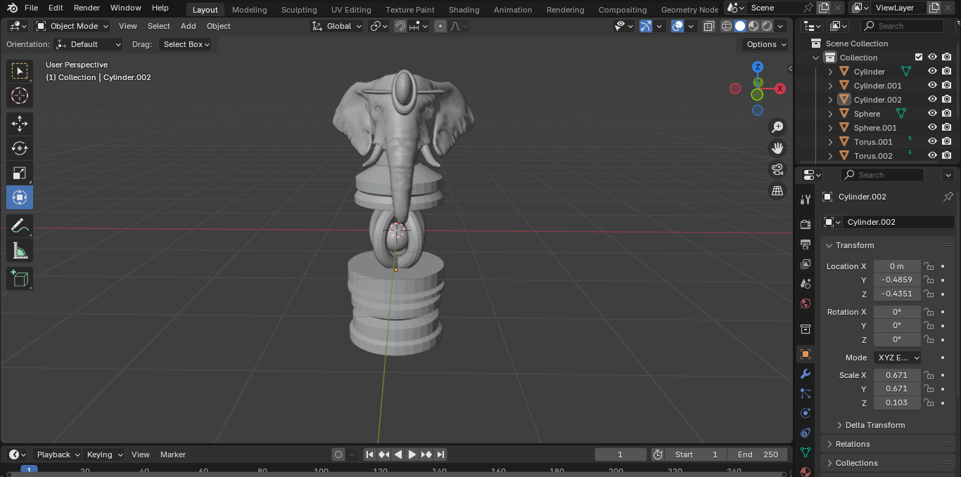
Rook Coin

Slide 20
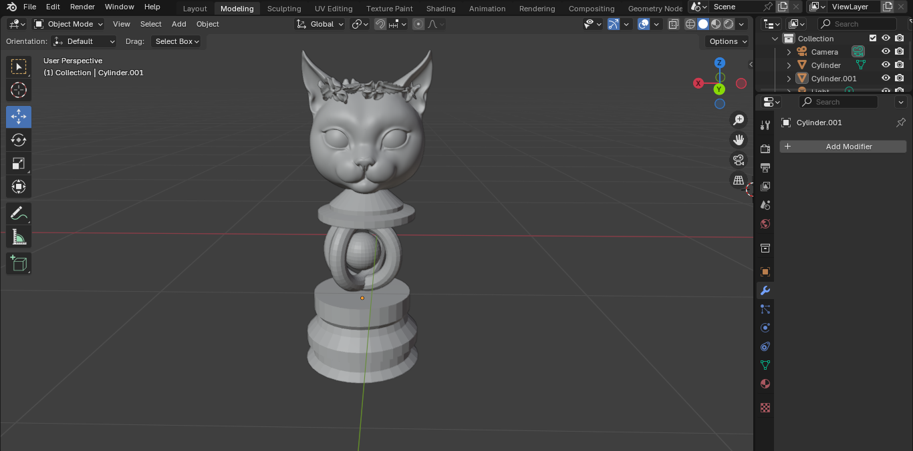
Pawn Coin

Slide 21
AI USING STOCKFISH
After the user makes a move, the turn is switched, and the current board state is retrieved. The FEN (Forsyth-Edwards Notation) string of the board is generated to represent the game's status.
The FEN string is passed to Stockfish, which analyzes the position and provides the best move. This move ensures optimal gameplay by the AI opponent.
The AI's move is executed on the board, and the turn is switched back to the user, allowing them to continue playing seamlessly.

Slide 22
VOICE RECOGNITION
Use Windows DictationRecognizer to capture voice commands like "Move pawn to e5.“
Parse the recognized text to extract the chess piece and target destination like piece=“pawn” and destination=“e5”.
Validate which piece of that type can legally move to the specified destination and execute the move accordingly.

Slide 23
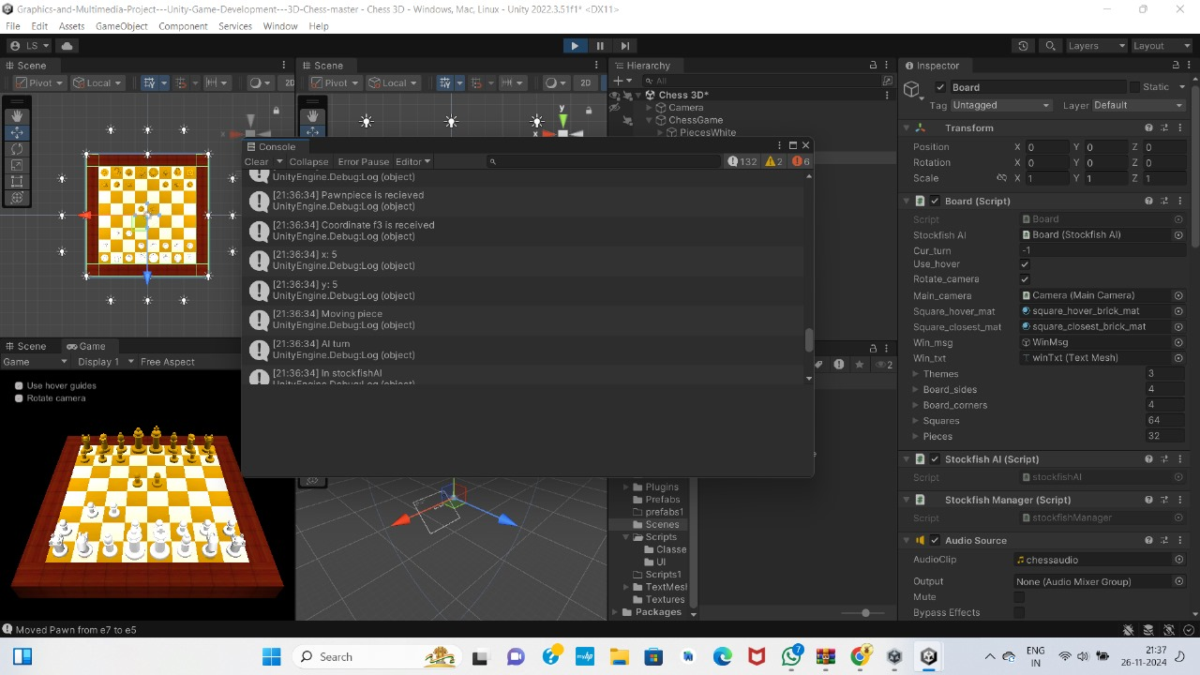

Slide 24


Slide 25
CONCLUSION
ECHOKNIGHT is not just an engaging chess experience; it stands as a testament to how technology can reinvent classic games to be more accessible, immersive, and enjoyable. By incorporating cutting-edge animation, AI-powered voice recognition, and intelligent AI opponents ,Chessgame-a unique blend of tradition and innovation has been created. This project lays the groundwork for future enhancements, such as advanced player analytics for skill improvement, smarter AI opponents, and enriched multiplayer capabilities. With ECHOKNIGHT, the timeless game of chess takes a bold step into the future, offering an experience that is both modern and deeply rooted in strategy and tradition.

Slide 26

FUTURE ENHANCEMENT
A database will be created to store the game state, including board positions, player turns, and moves made, allowing the game to be resumed from where it was left off.
Animations will be added for chess piece movements, and voice command feedback will announce moves like "Pawn moved to e5," enhancing interactivity.
Future updates will introduce difficulty levels, allowing players to choose the AI's skill level by adjusting Stockfish's depth and complexity settings.

Slide 27
REFERENCES
Jurtz, M. (2023). Chessboard Generation and Chess Engine Basics in Unity Using C#. Journal of Game Development and Simulation, 29(4), 225-239.
Akinyemi, O. (2021). "Speech Recognition in .NET for Command-Based Applications." International Journal of Computer Applications.
Kussul, B., & Baidyk, T. (2022). "Neural Networks in Game AI: A Case Study on Chess." International Journal of Artificial Intelligence, 18(4), 110-125.
Lee, D., & Kim, K. (2023). "Efficient Speech-to-Text Conversion with C# for Real-Time Applications." Computer Science & Engineering Journal, 15(1), 48-56.

Slide 28

THANK YOU

